Slide 1
Introduction to
MBA Course Preregistration
Marriott School of Management
Brigham Young University
rev. 3/12/2012, 10/13/2011
1

Slide 2



Overview
The MBA office has decided that after years of complaints from students they will revise the course registration system to avoid…
students staying up till midnight…
with three web browsers open at the same time…
typing as fast as they can!
Instead, providing a fairer preregistration system based on student preferences.

Slide 3
Basics of the preregistration system
Course bidding system.
Students rank courses.
Students allocate “points” to each class.
Points spent on courses in one round will not be available in subsequent rounds.
Lets see how it will work…

Slide 4
Give it a try
Go to…
http://services.byu.edu/mba
Enter BYU NetID and password
Notes:
Scroll down to bottom and click on “focus group”

Slide 5
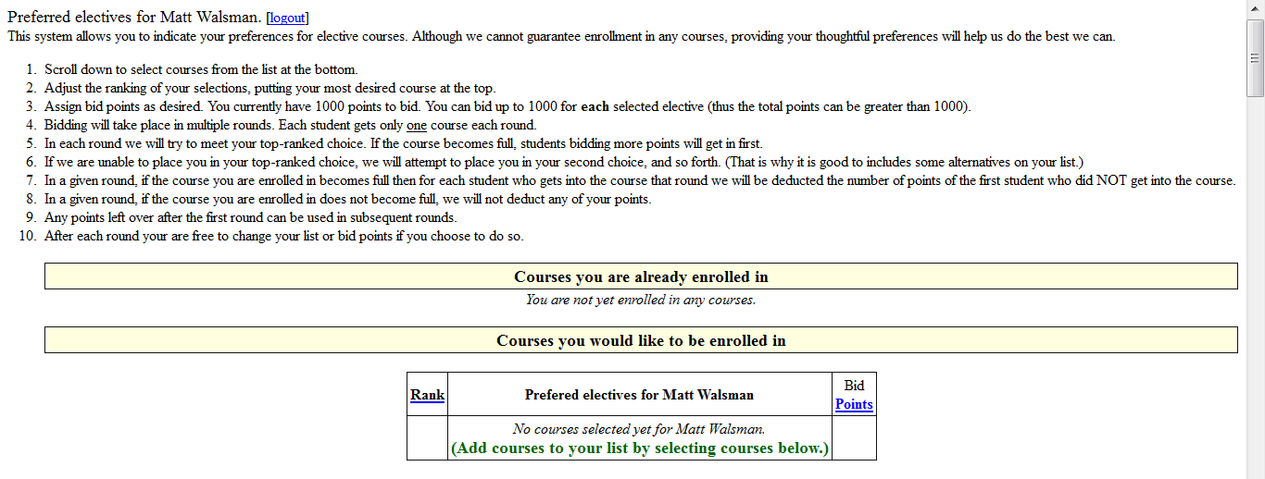
You should see something like this…
Read the instructions.
Give it a try.

Slide 6
How the system works

Slide 7

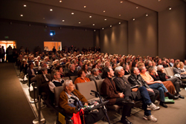
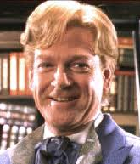
MaxBid points
eBay Automatic Bidding
MBA Preregistration
annthecan gets it for $21!
Highest “not in” MaxBid = 500
eBay bidder | Maximum Bid
annthecan | $25.50
bobdog | $20.01
carl934 | $20.00
deb_idaho | $18.00
MBA student | MaxBid points
Ann | 800
Bob | 501
Carl | 500
Deb | 300
in
cost=500
in
cost=500
not in
not in
Auto bid
($1 increment)
MBA 666
$18
$19
$20
$21
only 2 available seats

Slide 8
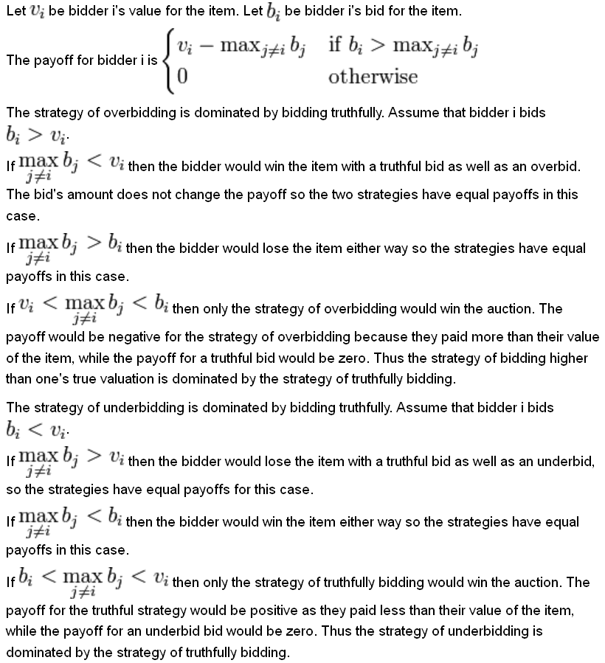
Why use a MaxBid auction?
Called “generalized second-price auction”
Based on “Vickrey auction”
Bottom line: The MaxBid approach…
  provides tremendous incentive to bid true preferences
  provides disincentive for attempting to “game” the bidding.
Your optimal bidding
strategy is to bid according
to your true preferences.

Slide 9
Gory details…
The system tries to get you in your top ranked class per round, based on demand and how many MaxBid points you allocated.
If you fail to get into your first choice in a particular round then your subsequent choice moves up.
  However, your subsequent choice is still subject to your specified MaxBid points.
The cost of getting into a class is the greater of:
  the minimum-bid amount (100 points)
  the bid of the first student who did NOT get into that course
You will get one and only one class each round (unless your preference list runs dry).
Let’s look at an example…

Slide 10
Example #1
These are the electives:
Ann wants these classes:
Bob wants these classes:
Available Courses | Seats
MBA 101 | 2
MBA 102 | 2
Rank | Ann’s Choices | Bid Points
1 | MBA 101 | 800
2 | MBA 102 | 500
Rank | Bob’s Choices | Bid Points
1 | MBA 102 | 600
2 | MBA 101 | 600

Slide 11
Example #1
Available Courses | Seats
MBA 101 | 2
MBA 102 | 2
Two rounds of preregistration…
  Round 1
    Ann gets in MBA 101
    Bob gets in MBA 102
  Round 2
    Ann gets in MBA 102
    Bob gets in MBA 101
Rank | Ann’s Choices | Bid Points
1 | MBA 101 | 800
2 | MBA 102 | 500
Rank | Bob’s Choices | Bid Points
1 | MBA 102 | 600
2 | MBA 101 | 600

Slide 12
Example #2
Available Courses | Avail Seats
MBA 101 | 2
MBA 102 | 3
Rank | Ann’s Choices | Bid Points
1 | MBA 101 | 800
2 | MBA 102 | 500
Four students.
Rank | Bob’s Choices | Bid Points
1 | MBA 102 | 600
2 | MBA 101 | 600
Rank | Carl’s Choices | Bid Points
1 | MBA 101 | 700
2 | MBA 102 | 350
Rank | Deb’s Choices | Bid Points
1 | MBA 101 | 500
2 | MBA 102 | 300

Slide 13
Example #2
Available Courses | Avail Seats
MBA 101 | 2
MBA 102 | 3
Rank | Ann’s Choices | Bid Points
1 | MBA 101 | 800
2 | MBA 102 | 500
X0
X1
X2
First round:
Rank | Bob’s Choices | Bid Points
1 | MBA 102 | 600
2 | MBA 101 | 600
Rank | Bid | Choice | Who
1 | 800 | MBA 101 | Ann
1 | 700 | MBA 101 | Carl
1 | 600 | MBA 102 | Bob
1 | 550 | MBA 101 | Deb
2 | 600 | MBA 101 | Bob
2 | 500 | MBA 102 | Ann
2 | 350 | MBA 102 | Carl
2 | 300 | MBA 102 | Deb
Rank | Carl’s Choices | Bid Points
1 | MBA 101 | 700
2 | MBA 102 | 350
Rank | Deb’s Choices | Bid Points
1 | MBA 101 | 550
2 | MBA 102 | 300

Slide 14
Example #2
Available Courses | Avail Seats
MBA 101 | 2
MBA 102 | 3
Rank | Ann’s Choices | Bid Points
1 | MBA 101 | 800
2 | MBA 102 | 500
Deb did not get in MBA 101, so the cost of MBA 101 in round 1 is 550 points.
X0
X1
X2
First round:
for round 2
XXX450
Rank | Bob’s Choices | Bid Points
1 | MBA 102 | 600
2 | MBA 101 | 600
Rank | Bid | Choice | Who
1 | 800 | MBA 101 | Ann
1 | 700 | MBA 101 | Carl
1 | 600 | MBA 102 | Bob
1 | 550 | MBA 101 | Deb
2 | 600 | MBA 101 | Bob
2 | 500 | MBA 102 | Ann
2 | 350 | MBA 102 | Carl
2 | 300 | MBA 102 | Deb
Rank | Carl’s Choices | Bid Points
1 | MBA 101 | 700
2 | MBA 102 | 350
450XXX
for round 2
ok
Rank | Deb’s Choices | Bid Points
1 | MBA 101 | 550
2 | MBA 102 | 300

Slide 15
Example #2
Available Courses | Avail Seats
MBA 101 | 2
MBA 102 | 3
Rank | Ann’s Choices | Bid Points
1 | MBA 101 | 800
2 | MBA 102 | 500
Deb’s second ranked course now becomes her first ranked course…
X0
X1
X2
First round:
XXX450
Rank | Bob’s Choices | Bid Points
1 | MBA 102 | 600
2 | MBA 101 | 600
Rank | Bid | Choice | Who
1 | 800 | MBA 101 | Ann
1 | 700 | MBA 101 | Carl
1 | 600 | MBA 102 | Bob
1 | 550 | MBA 101 | Deb
2 | 600 | MBA 101 | Bob
2 | 500 | MBA 102 | Ann
2 | 350 | MBA 102 | Carl
2 1 | 300 | MBA 102 | Deb
Rank | Carl’s Choices | Bid Points
1 | MBA 101 | 700
2 | MBA 102 | 350
450XXX
ok
Rank | Deb’s Choices | Bid Points
1 | MBA 101 | 550
2 | MBA 102 | 300

Slide 16
Example #2
Available Courses | Avail Seats
MBA 101 | 2
MBA 102 | 3
Rank | Ann’s Choices | Bid Points
1 | MBA 101 | 800
2 | MBA 102 | 500
X0
And the list is re-sorted by rank and bid points.
X1
X1
X2
First round:
XXX450
Rank | Bob’s Choices | Bid Points
1 | MBA 102 | 600
2 | MBA 101 | 600
Rank | Bid | Choice | Who
1 | 800 | MBA 101 | Ann
1 | 700 | MBA 101 | Carl
1 | 600 | MBA 102 | Bob
1 | 550 | MBA 101 | Deb
2 1 | 300 | MBA 102 | Deb
2 | 600 | MBA 101 | Bob
2 | 500 | MBA 102 | Ann
2 | 350 | MBA 102 | Carl
Rank | Carl’s Choices | Bid Points
1 | MBA 101 | 700
2 | MBA 102 | 350
ok
450XXX
Rank | Deb’s Choices | Bid Points
1 | MBA 101 | 550
2 | MBA 102 | 300

Slide 17
Example #2
Available Courses | Avail Seats
MBA 101 | 2
MBA 102 | 3
Rank | Ann’s Choices | Bid Points
1 | MBA 101 | 800
2 | MBA 102 | 500
X0
X1
X1
X2
First round:
XXX450
Round 1 over. MBA 102 dis not fill up so cost to get in 102 is 100 points.
Rank | Bob’s Choices | Bid Points
1 | MBA 102 | 600
2 | MBA 101 | 600
Rank | Bid | Choice | Who
1 | 800 | MBA 101 | Ann
1 | 700 | MBA 101 | Carl
1 | 600 | MBA 102 | Bob
1 | 550 | MBA 101 | Deb
2 1 | 300 | MBA 102 | Deb
2 | 600 | MBA 101 | Bob
2 | 500 | MBA 102 | Ann
2 | 350 | MBA 102 | Carl
Rank | Carl’s Choices | Bid Points
1 | MBA 101 | 700
2 | MBA 102 | 350
ok
450XXX
Rank | Deb’s Choices | Bid Points
1 | MBA 101 | 550
2 | MBA 102 | 300

Slide 18
Example #2
Available Courses | Avail Seats
MBA 101 | 2
MBA 102 | 3
Rank | Ann’s Choices | Bid Points
1 | MBA 101 | 800
2 | MBA 102 | 500
X0
X1
X0
X1
X2
Second round:
XXX450
Rank | Bob’s Choices | Bid Points
1 | MBA 102 | 600
2 | MBA 101 | 600
Rank | Bid | Choice | Who
1 | 800 | MBA 101 | Ann
1 | 700 | MBA 101 | Carl
1 | 600 | MBA 102 | Bob
1 | 550 | MBA 101 | Deb
2 1 | 300 | MBA 102 | Deb
2 | 600 | MBA 101 | Bob
2 | 500 | MBA 102 | Ann
2 | 350 | MBA 102 | Carl
Rank | Carl’s Choices | Bid Points
1 | MBA 101 | 700
2 | MBA 102 | 350
ok
450XXX
Rank | Deb’s Choices | Bid Points
1 | MBA 101 | 550
2 | MBA 102 | 300

Slide 19
Remember…
Course requests are considered in rank order.
High bidders will get in courses first.
The cost getting into a class is the greater of:
  the minimum-bid amount (100 points)
  the bid of the first student who did NOT get into that course
Any unused points get returned for subsequent rounds.
You will have opportunities to adjust your points after each round, but do not need to.

Slide 20
If you want to participate…
Log in at http://services.byu.edu/mba
Select and rank your desired courses, assigning MaxBid points, before the Preregistration date.
Log out.
The actual MBA preregistration will take place in 151 TNRB on that date.
  All MaxBid points entered before that time will have equal consideration (no speed advantage ☺).
  If you would like to attend that meeting you are welcome (and you can adjust MaxBid points between rounds).
  If you correctly specified your MaxBid points initially, you should not need to adjust points between rounds.
You do NOT need to
attend the preregistration
meeting to participate

Slide 21
If you not want to participate…
Regular MBA registration reportedly begins the Monday following at 12:00am.
However, MBA Electives will require a registration flag for the first week of registration.
Registration flags will be given to students with winning bids from preregistration.
After the first week of registration, any student can vie for any available space in MBA courses.
Students with registration flags must use them the first week of registration, or lose the advantage.

Slide 22
Frequently Asked Questions
What is keeping me from bidding 1000 for every course and seeing what the market dictates?
Answer: Nothing. You may bid 1000 points every round but you do so at a risk. If all 1000 points are required to get a course you will not have any remaining points for subsequent rounds.

Slide 23
Frequently Asked Questions
What if many students bid the same amount for a course and the course fills up? Who gets in the course?
Answer: Each round the students are given a tie-break ordering. Those students with a higher tie-break will get in that course. The tie-break ordering is re-generated every round.

Slide 24
Frequently Asked Questions
What if there are two sections of a course, but I only want to get in one of the two?
Answer: If you put two sections of the same course on your preference list, as soon as you are granted one of the sections the other section will automatically be excluded from your list.
This does not apply to MBA 693R classes, where the “R” means repeatable. (You can take multiple 693R class in a given semester.)

Slide 25
Questions?

