Slide 1
A basic introduction to PCN Analysis with the Malawi’s Pizza Catering case
Dr. Scott E. Sampson
James M. Passey Professor of Service Operations Management
Brigham Young University ©2014
Provo, Utah, USA
http://services.byu.edu
For educational use only. Images used according to section 107 of US copyright code.
Notes:
Quick on what are services.
Right into PCN Analysis.
Does not cover ☺.
Has SPP exercise.
Finishes with innovation.

Slide 2

Your MISSION:
POSSIBLE
document a service operation
identify sources of value
identify process problems
inefficiencies and other costs
potential service failures
flaws in the customer experience
explore possible process improvements
identify opportunities for innovation
PCN Analysis

Slide 3
Steps of basic PCN Analysis
Identify system entities and roles
Document key processes
Assess value propositions
Generate strategic improvement alternatives

Slide 4
Steps of basic PCN Analysis
Identify system entities and roles
Document key processes
Assess value propositions
Generate strategic improvement alternatives

Slide 5
1. Identify entities and roles
Principle Individual
Event planner
Caterer
Venue host
Event attendees
Notes:
Principle Individual – provides occasion and money
Event planner – provides planning expertise
Caterer – provides food
Venue host – provides venue
Event attendees – provide support

Slide 6
Steps of basic PCN Analysis
Identify system entities and roles
Document key processes
Assess value propositions
Generate strategic improvement alternatives
PCN Diagram

Slide 7
Elements of a PCN Diagram
Process Entity
Process Domain
Process Regions

Slide 8
Process Entity
Notes:
Principle Individual – provides occasion and money
Event planner – provides planning expertise
Caterer – provides food
Venue host – provides venue
Event attendees – provide support

Slide 9
Process Entity
Principle Individual
Event planner
Caterer
Venue host
Event attendees
Notes:
Principle Individual – provides occasion and money
Event planner – provides planning expertise
Caterer – provides food
Venue host – provides venue
Event attendees – provide support

Slide 10
Process Entity
 |  | Entity
 | Entity’s Process Domain
An entity’s Process Domain includes all processes that are directly performed, directed, controlled by the entity.

Slide 11
Process Domain
 |  | Pizza Restaurant
 | Restaurant’s Process Domain

Slide 12
Process
 |  | Pizza Restaurant
 | Restaurant’s Process Domain
negotiate
supply
contract
identify ingredients
develop
recipes
take order
forecast
supply needs
preheat
ovens
cook
pizza
order
supplies
online
receive supplies
maintain
supplies
serve
pizza
Notes:
12
https://www.straight.com/files/styles/popup/public/GP_SurveyResults_2360.jpg

Slide 13
Process
 |  | Pizza Restaurant
 | Restaurant’s Process Domain
negotiate
supply
contract
identify ingredients
develop
recipes
take order
forecast
supply needs
preheat
ovens
cook
pizza
order
supplies
online
receive supplies
maintain
supplies
serve
pizza
Notes:
13

Slide 14
Three regions of a Process Domain
 |  | Pizza Restaurant
 | Restaurant’s Process Domain
Direct interaction (e.g. with supplier) | Surrogate interaction (e.g. acting on supplier resources) | Independent processing (entity acting on entity’s owned/controlled resources) |  | Surrogate interaction (e.g. acting on customer resources) | Direct interaction (e.g. with customer)
negotiate
supply
contract
identify ingredients
develop
recipes
take order
forecast
supply needs
preheat
ovens
cook
pizza
order
supplies
online
receive supplies
maintain
supplies
serve
pizza

Slide 15
Three regions of a Process Domain
 |  | Pizza Restaurant
 | Restaurant’s Process Domain
Direct interaction | Surrogate interaction | Independent processing |  | Surrogate interaction | Direct interaction
degree of process control
degree of process control
negotiate
supply
contract
identify ingredients
develop
recipes
take order
forecast
supply needs
preheat
ovens
cook
pizza
order
supplies
online
receive supplies
maintain
supplies
serve
pizza

Slide 16
Three regions of a Process Domain
1. Direct Interaction
Entity person acting in conjunction with another entity person.
People with people.
2. Surrogate Interaction
Entity person acting on/with resource(s) of another entity.
People with things (belongings, information).
3. Independent Processing
Entity acting only on/with entity’s own resources.

Slide 17

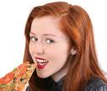
PCN Diagram
 |  | Restaurant Supplier
 | Supplier’s Process Domain
Direct interaction | Surrogate interaction | Independent processing |  | Surrogate interaction | Direct interaction
 |  | Pizza Restaurant
 | Restaurant’s Process Domain
Direct interaction | Surrogate interaction | Independent processing |  | Surrogate interaction | Direct interaction
 |  | Pizza Consumer
 | Consumer’s Process Domain
Direct interaction | Surrogate interaction | Independent processing |  | Surrogate interaction | Direct interaction
seat customer
wait to be
seated
develop
appetite
negotiate
supply
contract
identify ingredients
develop
recipes
create order
review menu
forecast
supply needs
preheat
ovens
cook
pizza
order
supplies
online
wait for
pizza
eat
leftovers
fill
order
serve
pizza
eat
pizza
receive supplies
maintain
supplies
prepare check
present check
pay check
return home

Slide 18
Case: Malawi’s Pizza Catering
Creating a PCN Diagram
based on information from the case.

Slide 19

Pizza catering planning process

Slide 20
Pizza catering planning process
ask event date, type, # attend
call Malawi’s
need catering
check schedule
provide event information
explore alternatives
date
available
?
no
yes
arrange meeting
wait
calculate quantity
discuss menu options and taste test
price
acceptable
?
explore
other alternatives
determine price
discuss price
no
record in catering book
book catering engagement
yes

Slide 21
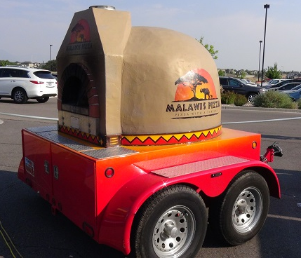
Food preparation and delivery process
assemble pizzas
par cook pizzas
maintain mobile oven
load food and supplies on trailer
drive to venue
determine parking plan
clear
parking
space?
no
discuss alternative parking locations
yes
park trailer
unload trailer
A

Slide 22
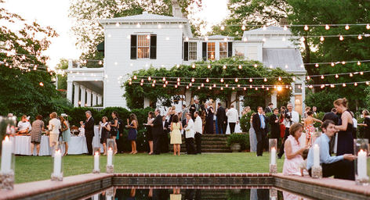
Food preparation and delivery process
A
setup portable kitchen
location
of serving area
obvious?
no
discuss serving location
yes
setup serving area
wait for event
start
heat pizzas
monitor pizza consumption
take pizzas to serving area
eat pizza

Slide 23

Cleanup and payment process
clean up portable kitchen
load trailer
determine actual number of pizzas consumed
prepare final invoice
present invoice
provide payment
clean up serving and eating tables
return to store
unload trailer

Slide 24
Steps of basic PCN Analysis
Identify system entities and roles
Document key processes
Assess value propositions
Generate strategic improvement alternatives

Slide 25
Pizza catering planning process
+$ value? ☺
ask event date, type, # attend
-$ costs? ☹
call Malawi’s
need catering
check schedule
provide event information
explore alternatives
date
available
?
no
yes
arrange meeting
wait
-$
☹
calculate quantity
discuss menu options and taste test
price
acceptable
?
explore
other alternatives
determine price
discuss price
no
☺
record in catering book
book catering engagement
yes

Slide 26
Food preparation and delivery process
+$ value? ☺
assemble pizzas
☺
-$ costs? ☹
par cook pizzas
maintain mobile oven
load food and supplies on trailer
-$
drive to venue
determine parking plan
clear
parking
space?
no
discuss alternative parking locations
yes
park trailer
unload trailer
A

Slide 27
Food preparation and delivery process
+$ value? ☺
A
-$ costs? ☹
setup portable kitchen
location
of serving area
obvious?
no
discuss serving location
yes
setup serving area
wait for event
start
-$
heat pizzas
monitor pizza consumption
take pizzas to serving area
eat pizza
☺

Slide 28
Cleanup and payment process
+$ value? ☺
-$ costs? ☹
clean up portable kitchen
load trailer
determine actual number of pizzas consumed
☹
+$
prepare final invoice
present invoice
provide payment
clean up serving and eating tables
return to store
unload trailer

Slide 29
Steps of basic PCN Analysis
Identify system entities and roles
Document key processes
Assess value propositions
Generate strategic improvement alternatives
Improved economies of scale?
Improved customization?
Improved efficiency?
Improved scalability?
Improved consistency?
Improved quality?
Improved value?

Slide 30
Food preparation and delivery process
assemble pizzas
par cook pizzas
maintain mobile oven
load food and supplies on trailer
drive to venue
determine parking plan
clear
parking
space?
no
discuss alternative parking locations
yes
park trailer
unload trailer
A

Slide 31
Your MISSION:

Slide 32
Your MISSION:
Identify system entities and roles
Document key processes
Assess value propositions
Generate strategic improvement alternatives
Improved economies of scale?
Improved customization?
Improved efficiency?
Improved scalability?
Improved consistency?
Improved quality?
Improved value?
Explain and
justify.
Keep it simple.
Summary sheet at
http://services.byu.edu

